Slide 1



Analysis of the Air Quality Index(AQI) in the United States
Presenter
Manasa Cherukupally

Slide 2
Agenda
Introduction
Data Preprocessing
Feature Engineering
Data visualization
Future goals goals

Slide 3
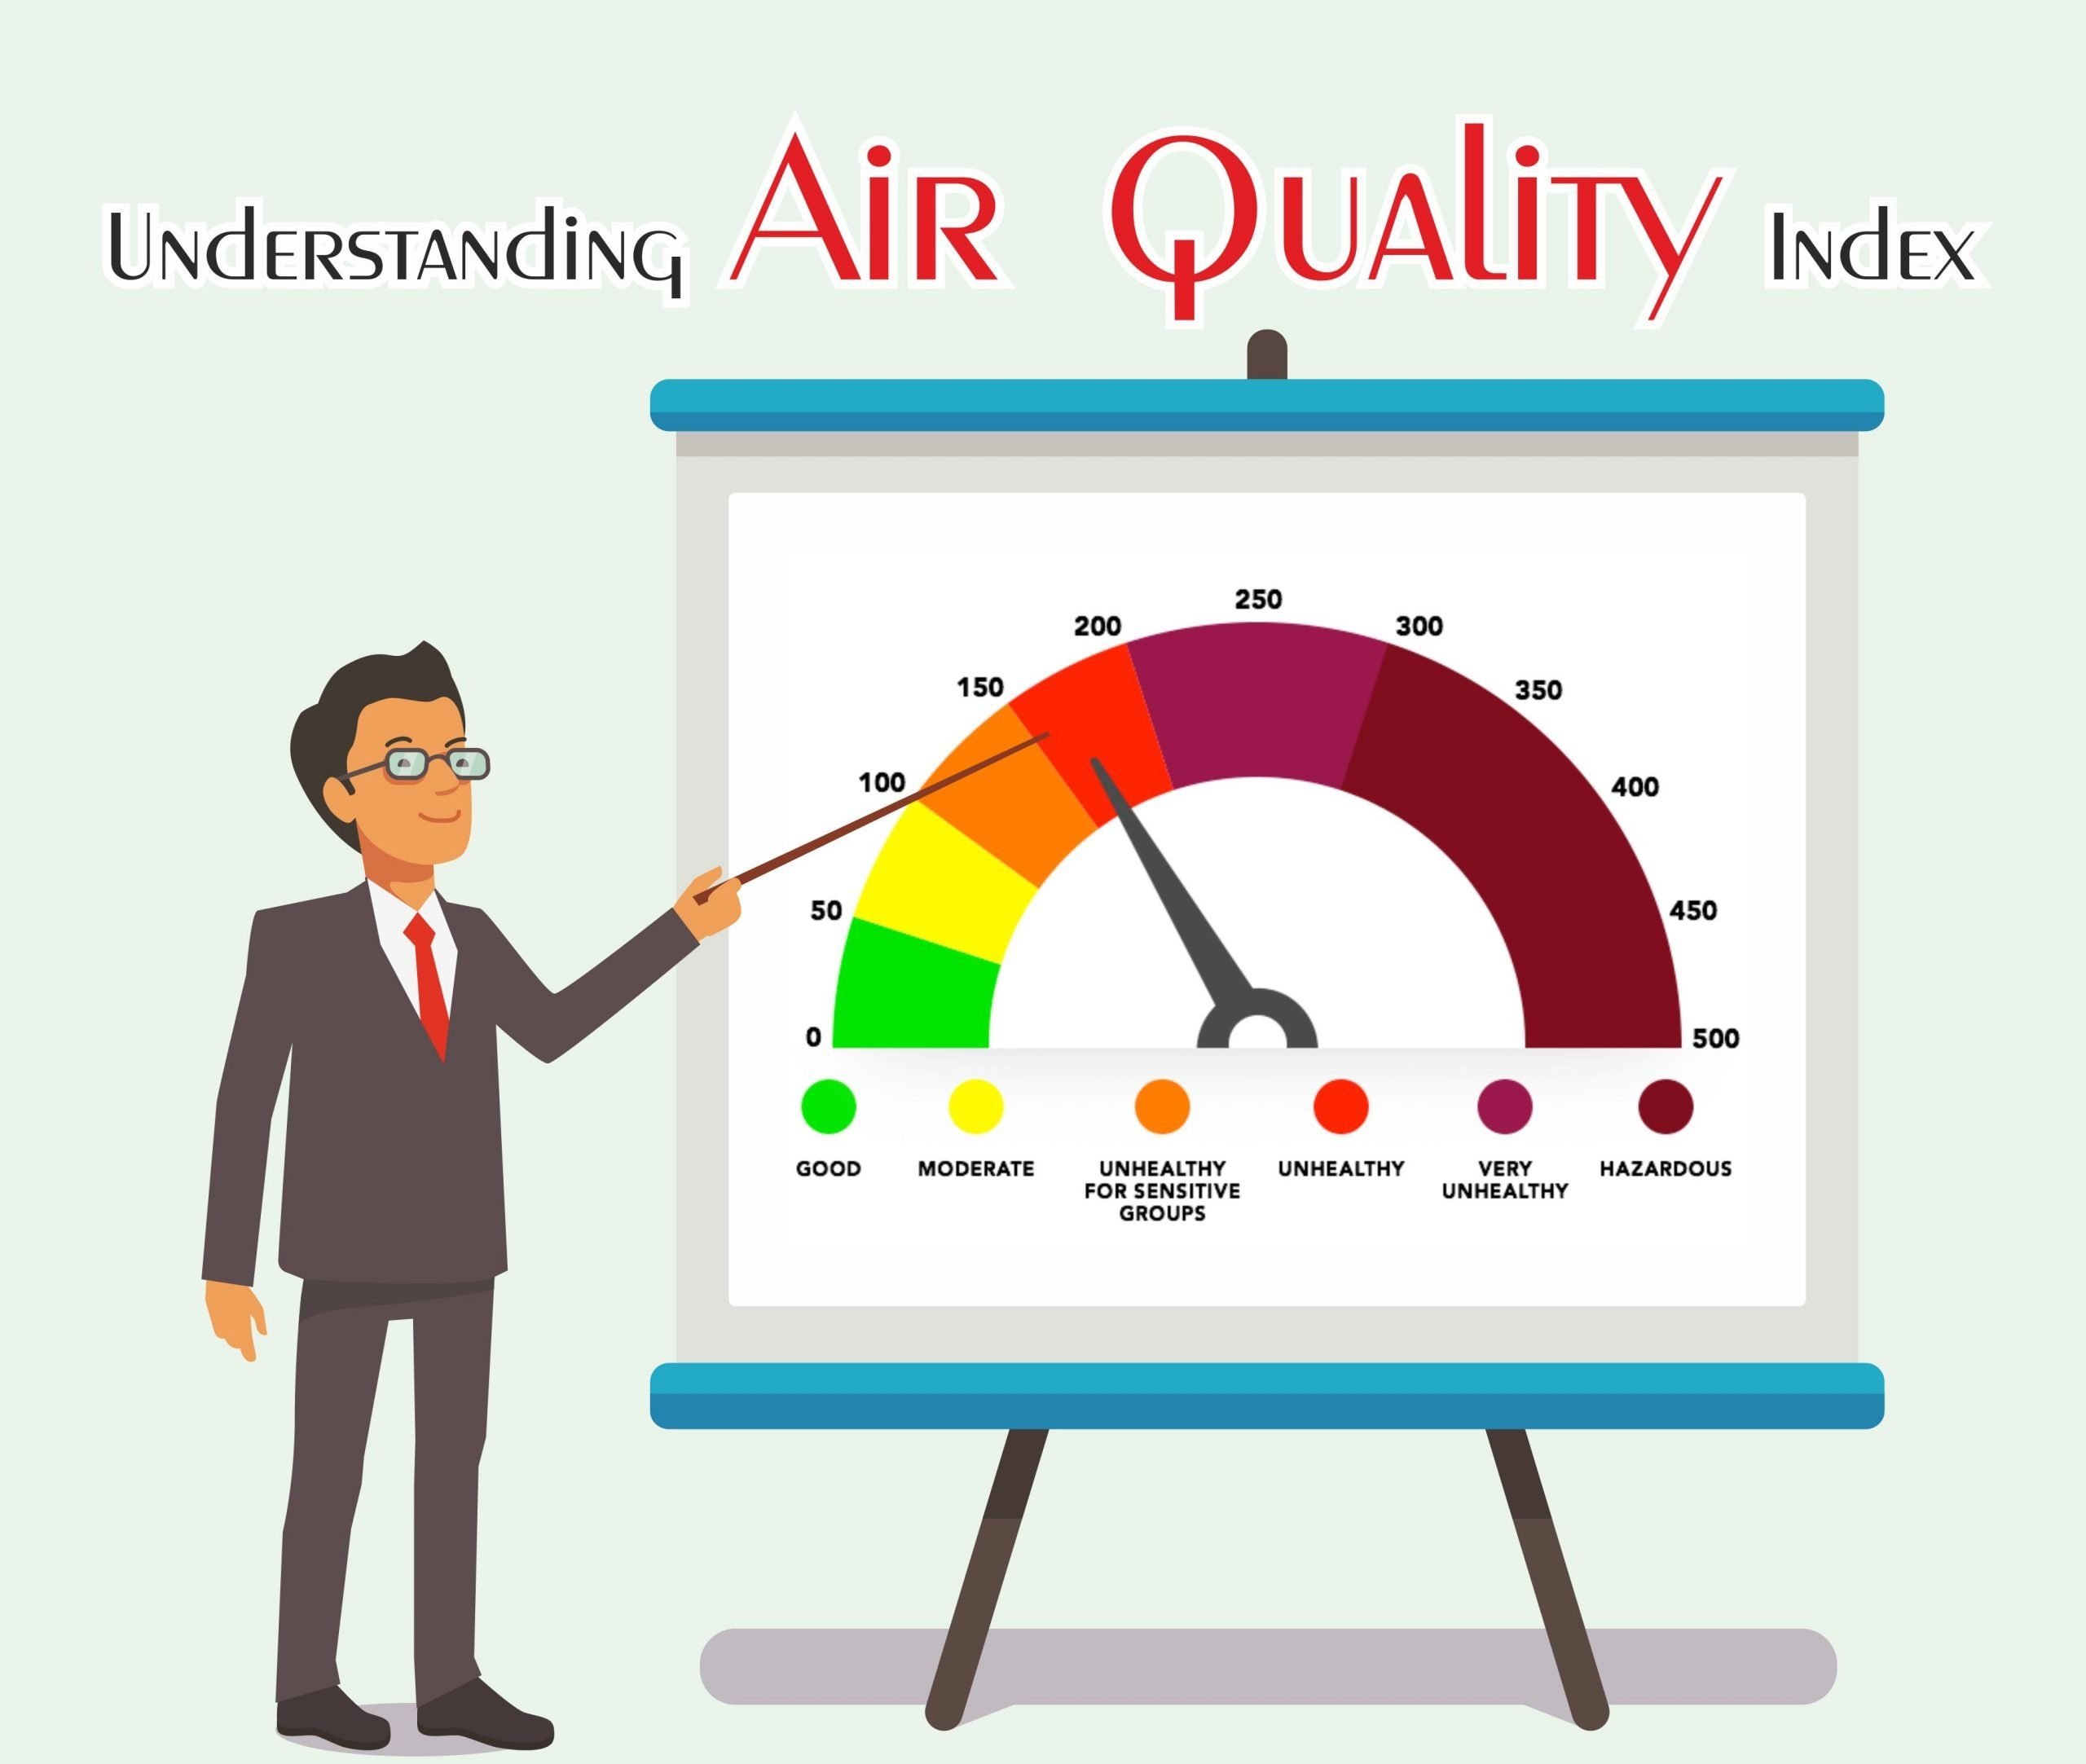
Introduction
Air pollution is one of the major problems in the current world. Human being’s health is highly affected by the air they intake.
Less air quality can major diseases like respiratory and cardiovascular problems.
Air Quality Index (AQI) is a measurement that will be used to know to what extent air is polluted in a particular location at a given time.
Air Quality Index (AQI) is measured by Environmental Protection Agency (EPA) at regular intervals.
EPA at different locations measures level of pollutants such as
particulate matter (PM2.5 and PM10)
ozone (O3)
nitrogen dioxide (NO2)
carbon monoxide (CO)
sulfur dioxide (SO2)
3

Slide 4
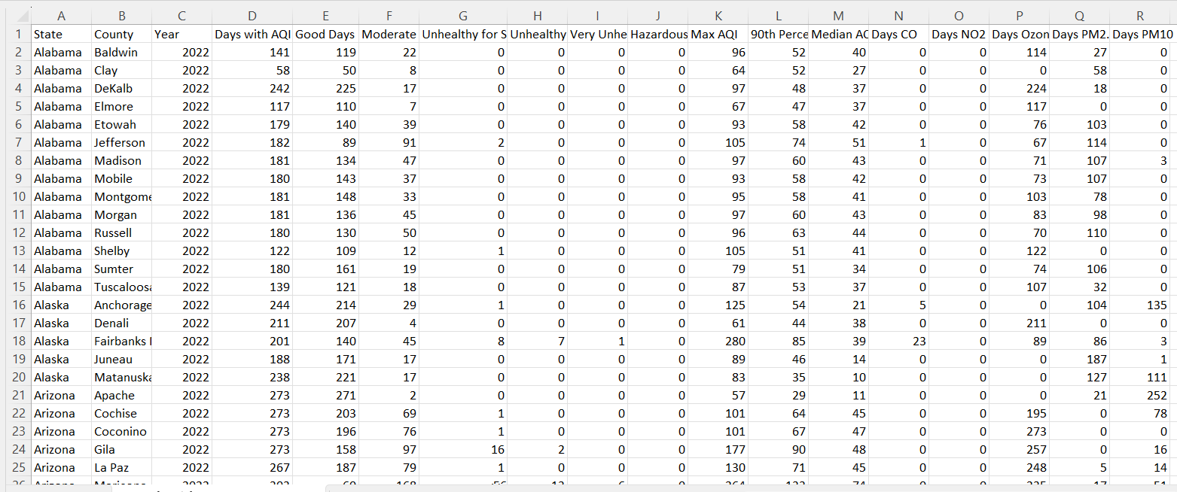
Dataset
4

Slide 5
Variables
Variable | Description
Days with AQI | Number of days in the year that is having the Air Quality Index value
Days Good | Number of days in the year AQI value 0 through 50.
Days Moderate | Number of days in the year AQI value 51 through 100.
Days Unhealthy for Sensitive Groups | Number of days in the year AQI value 101 through 150.
Days Unhealthy | Number of days in the year AQI value 151 through 200.
Days Very Unhealthy | Number of days in the year AQI value 201 through 300.
Days Hazardous | Number of days in the year having an AQI value 301 through 500.
AQI Max | The daily AQI highest value in the year.
AQI 90th %ile | AQI values during the year were less than or equal to the 90% value.
AQI Median | Half of daily AQI values during the year that is <= median value
Days CO Days NO2 Days O3 Days PM2.5 Days PM10 | These columns give the number of days each pollutant measured which is the main pollutant.
year | Year when metric taken
State | State of United States
County | County for each state in United States
The data set consists of 5013 rows and 20 columns
There are both categorical and numerical variables
The dataset has the state name and county name of each state from where EPA collected the data from.
The dataset collected annually is not based on daily data but for a few days a year.
5

Slide 6
Data Preprocessing
6

Slide 7

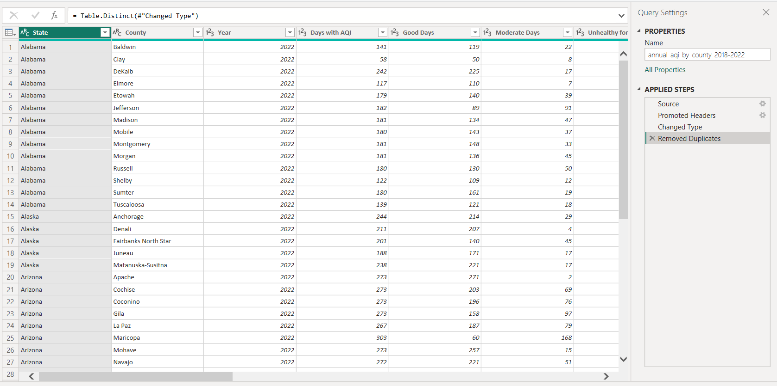
Change the datatypes: the datatypes were changed from categorical to numerical values Remove missing values: Since there are no missing values, these steps need not be done Remove duplicates: duplicate rows from the data should be removed
7

Slide 8
Feature Engineering
8

Slide 9
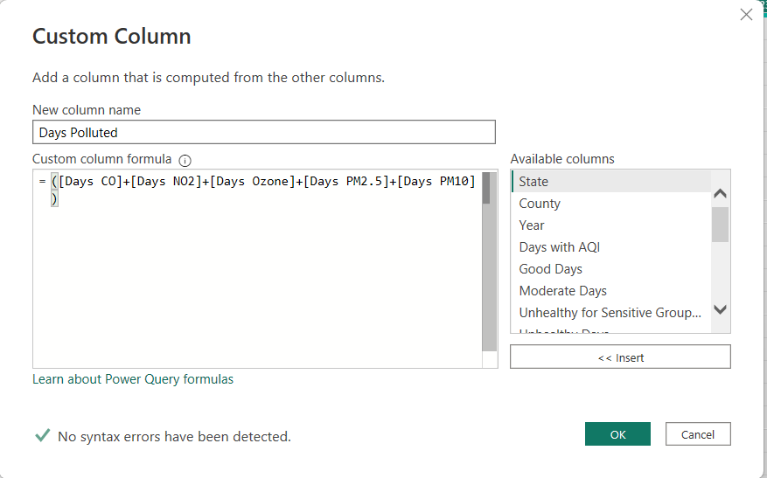
Added a new feature to the dataset “Days Polluted” which is the sum of days when anyone of the poisonous gas was high.
9

Slide 10
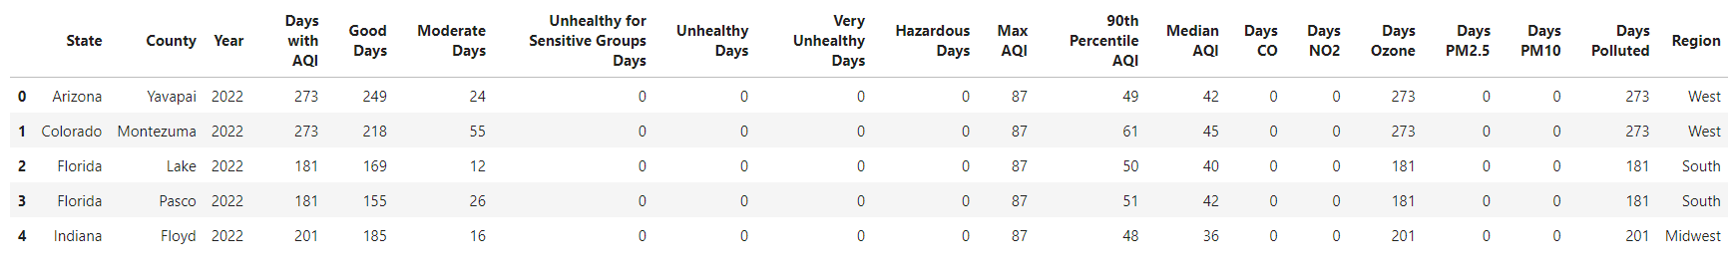
Added a new feature to the dataset “Region” which takes the input column ‘state’ and categorizes it to the region based on its geographical location.
10

Slide 11




Data Visualization

Slide 12
Question : Which states in the united states have the most average unhealthy days from the year (2018-2022)
12

Slide 13
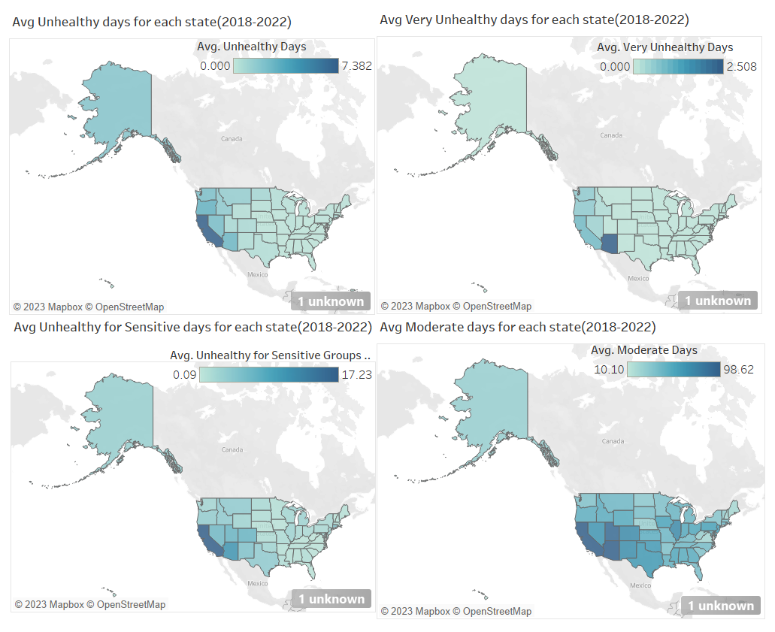
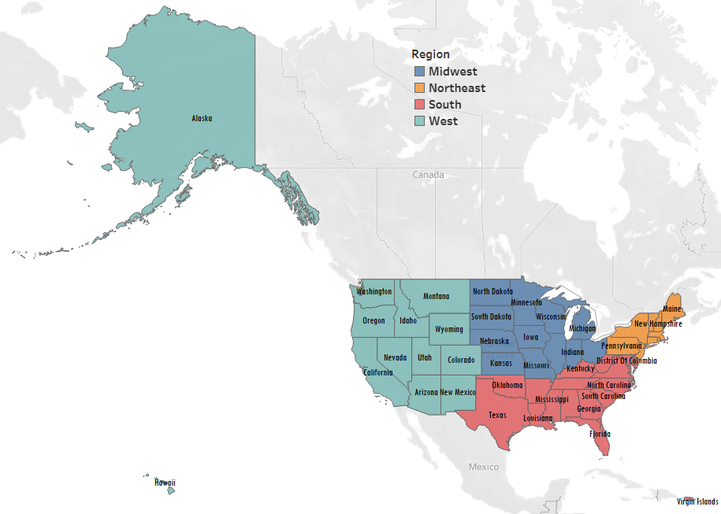
Inference:
It can be inferred that California and Arizona states have more unhealthy days when compared to other states.
Both regions belong to the Western region of Unites states.
13

Slide 14
Question : Which states in the united states have the Good air days from the year (2018-2022)
14

Slide 15
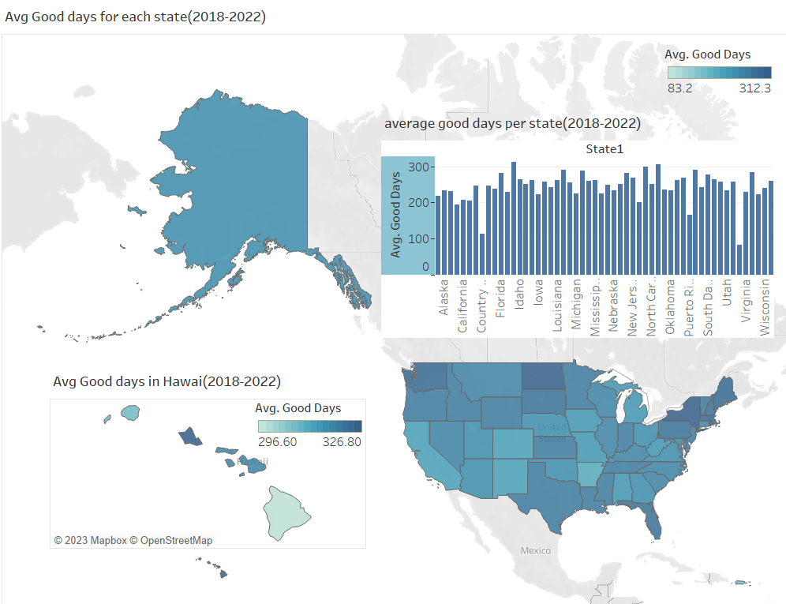
Inference:
It can be inferred that the Hawaiian Islands have more good days when compared to other states.
Honollu in the Hawaiian Islands have the highest number of good days over the period of (2018-2022)
15

Slide 16
Question : How does the trend in Air Quality Index(AQI) change over 5 years (2018-2022)
16

Slide 17
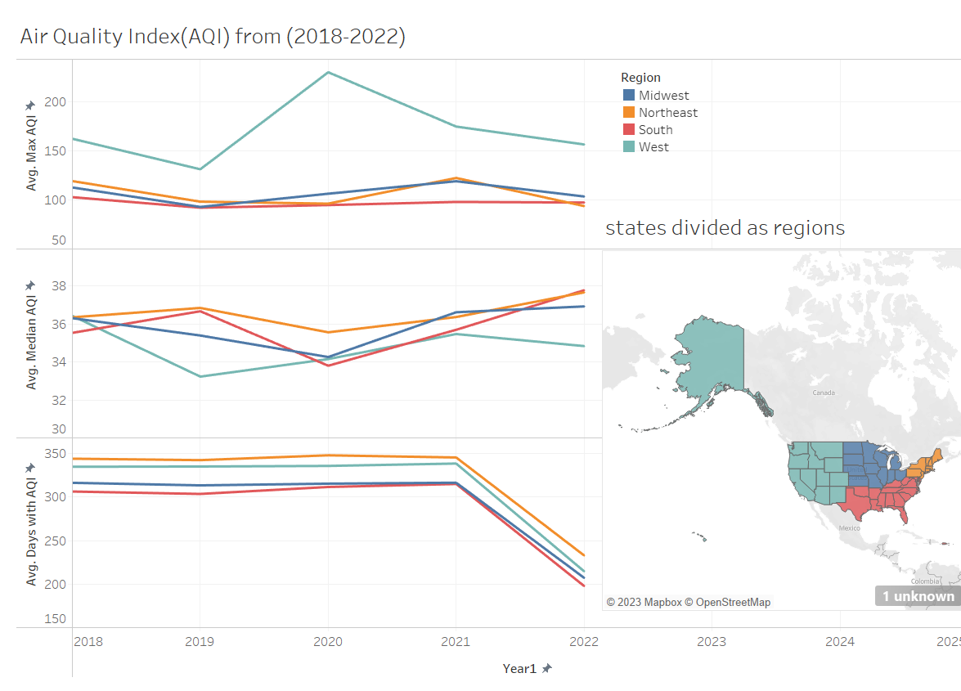
Inference:
It can be inferred that the days with Max AQI have slightly decreased in 2022
And Median AQI slightly increased in 2022
Northeast region has more Median AQI days, least is for the West region
Western region has more number of Max AQI days and the south region has less number of Max AQI days
17

Slide 18
Question : Which gases are responsible for most of pollution in different states and the days of pollution over the period(2018-2022)
18

Slide 19
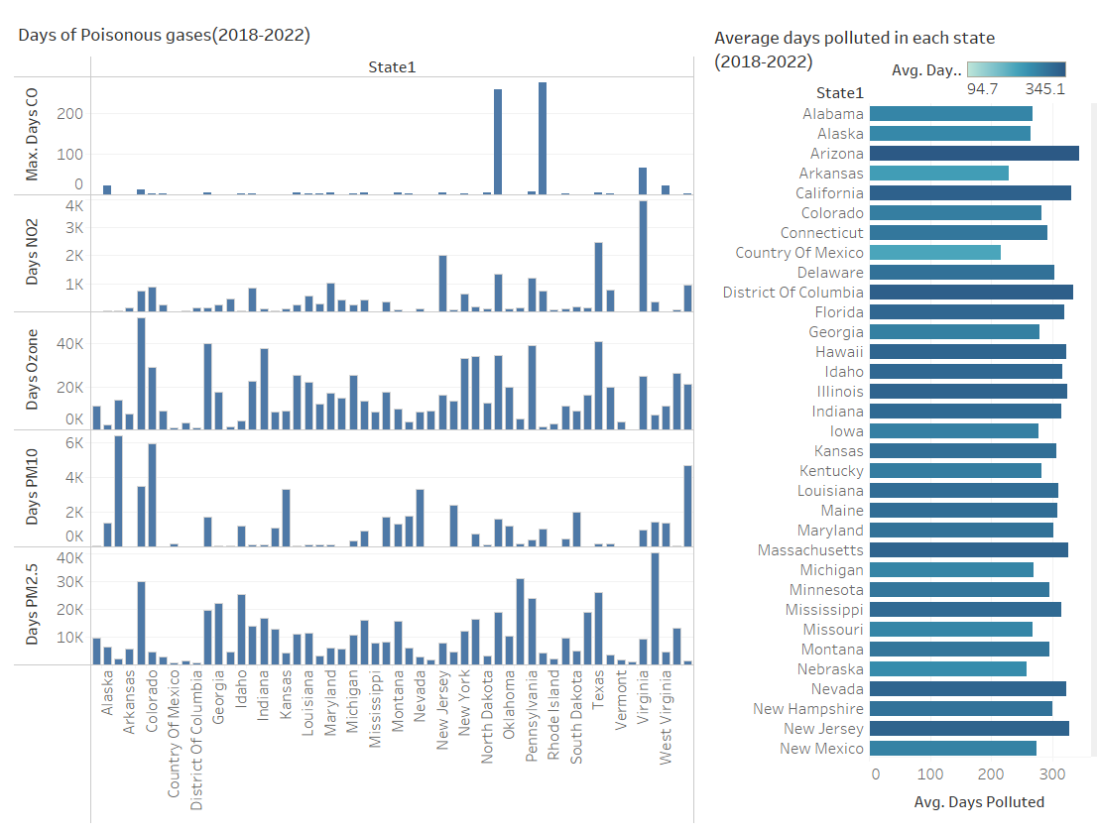
Inference:
It can be inferred that
Max CO days - Ohio, Puerto Rico
Max NO2 days- Virginia
Max Ozone days - California, Texas
Max PM10 days – Arizona, Colorado
Max PM2.5 days – Washington, California
Overall Maximum polluted days are in Arizona followed by California and District of Columbia
19

Slide 20
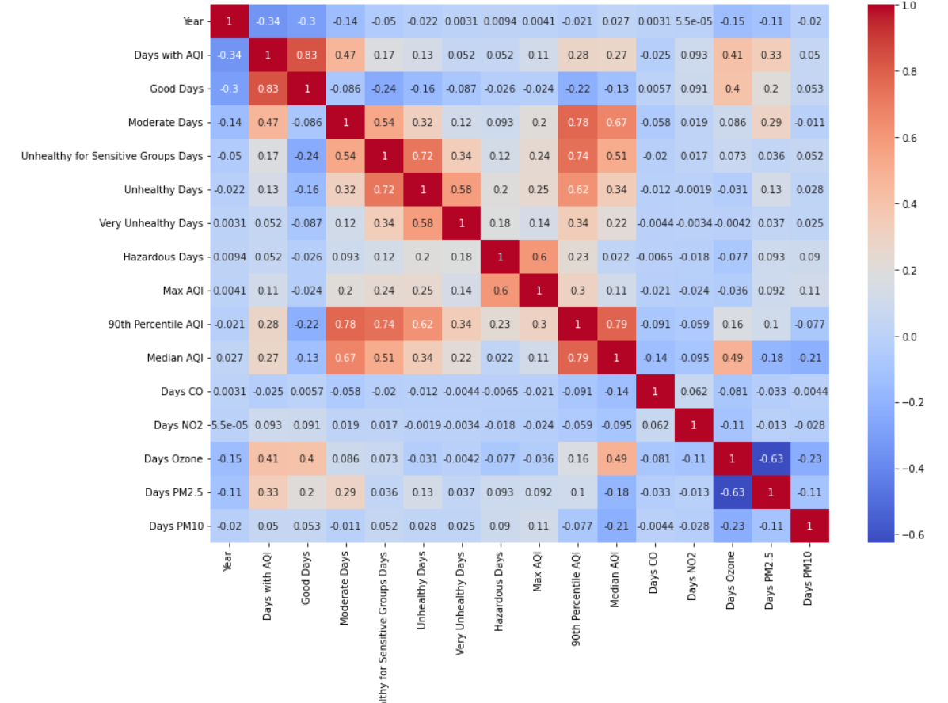
20

Slide 21
Future Work
More analysis can be done in understanding the AQI
More feature engineering can be done to produce meaningful variables
Data for a longer period can be extracted to analyze the AQI

Slide 22
Thank you

Slide 23
References
Understanding Air Quality Index (AQI). https://www.ankitparakh.com/understanding-air-quality-index-aqi/
United States Environmental Protection Agency. https://www.epa.gov/outdoor-air-quality-data/about-air-data-reports

